Slide 1


HOTEL RESERVATION ANALYSIS SQL
PRESENTED BY
BONI ACOBE ANGE ULRICH -- MIP-DA-10

Slide 2
CONTENT
01
03
About Project
Analysis Tools
02
04
About Dataset
Analysis Results
1

Slide 3

ABOUT PROJECT
In this internship, we leverage data from a hotel reservation dataset to enhance decision-making and improve guest experiences. By using SQL to query and analyze the data, we uncover insights into guest preferences, booking trends, and key operational factors impacting the hotel industry.
2

Slide 4
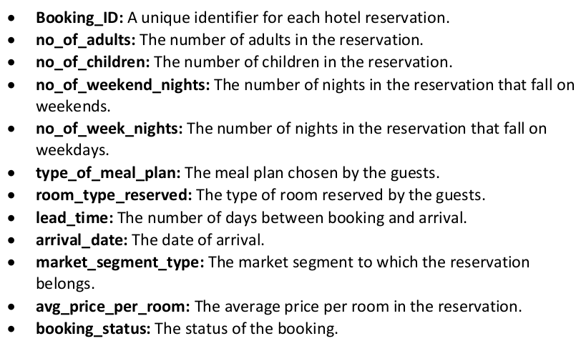
ABOUT DATASET
3

Slide 5

ANALYSIS TOOLS
SQL Server is a relational database management system developed by Microsoft. It supports a wide range of transaction processing, business intelligence, and analytics applications. With SQL Server, users can store, retrieve, and manipulate data efficiently, making it an essential tool for data management and analysis in various industries.
4

Slide 6

ANALYSIS TOOLS
Azure Data Studio is a cross-platform database tool developed by Microsoft for data professionals. It offers a modern editor experience with built-in Git support, integrated terminal, and customizable dashboards. Azure Data Studio is designed for managing SQL Server and Azure SQL databases, providing a seamless experience for querying, developing, and administering databases.
4

Slide 7
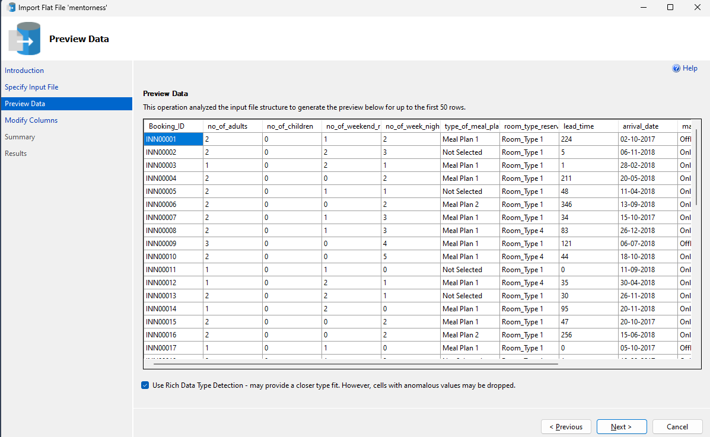
ANALYSIS TOOLS
4

Slide 8
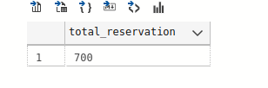
ANALYSIS RESULTS
WHAT IS THE TOTAL NUMBER OF RESERVATIONS IN THE DATASET?
SELECT COUNT(*) TOTAL_RESERVATION
FROM hotels;
5

Slide 9

ANALYSIS RESULTS
2. WHICH MEAL PLAN IS THE MOST POPULAR AMONG GUESTS?
SELECT TOP 1 TYPE_OF_MEAL_PLAN, COUNT(*) AS TOTAL_ORDER
FROM hotels
GROUP BY type_of_meal_plan
ORDER BY total_order DESC;
5

Slide 10
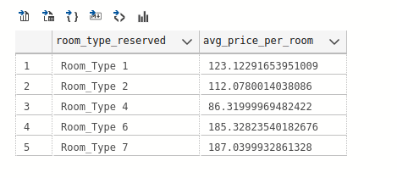
ANALYSIS RESULTS
3. WHAT IS THE AVERAGE PRICE PER ROOM FOR RESERVATIONS INVOLVING CHILDREN?
SELECT ROOM_TYPE_RESERVED, AVG(AVG_PRICE_PER_ROOM) AS AVG_PRICE_PER_ROOM
FROM hotels
WHERE no_of_children > 0 GROUP BY room_type_reserved;
5

Slide 11
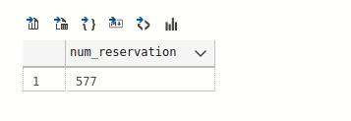
ANALYSIS RESULTS
4. HOW MANY RESERVATIONS WERE MADE FOR THE YEAR 2018
SELECT COUNT(*) AS NUM_RESERVATION
FROM hotels WHERE YEAR(arrival_date) = 2018
5

Slide 12
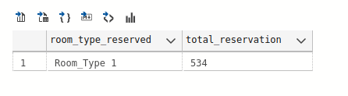
ANALYSIS RESULTS
5. WHAT IS THE MOST COMMONLY BOOKED ROOM TYPE?
SELECT TOP 1 ROOM_TYPE_RESERVED, COUNT(*) TOTAL_RESERVATION
FROM hotels
GROUP BY room_type_reserved
ORDER BY total_reservation DESC;
5

Slide 13
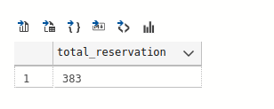
ANALYSIS RESULTS
6. HOW MANY RESERVATIONS FALL ON A WEEKEND (NO_OF_WEEKEND_NIGHTS > 0)?
SELECT COUNT(*) AS TOTAL_RESERVATION
FROM hotels
WHERE no_of_weekend_nights > 0
5

Slide 14
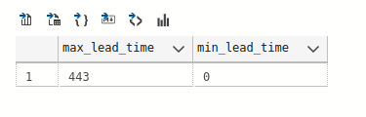
ANALYSIS RESULTS
7. WHAT IS THE HIGHEST AND LOWEST LEAD TIME FOR RESERVATIONS?
SELECT MAX(LEAD_TIME) AS MAX_LEAD_TIME, MIN(LEAD_TIME) AS MIN_LEAD_TIME
FROM hotels
5

Slide 15
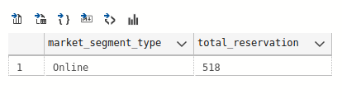
ANALYSIS RESULTS
8. WHAT IS THE MOST COMMON MARKET SEGMENT TYPE FOR RESERVATIONS?
SELECT TOP 1 MARKET_SEGMENT_TYPE, COUNT(*) AS TOTAL_RESERVATION
FROM hotels
GROUP BY market_segment_type
ORDER BY total_reservation DESC
5

Slide 16
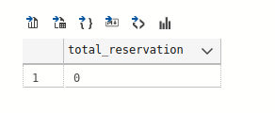
ANALYSIS RESULTS
9. HOW MANY RESERVATIONS HAVE A BOOKING STATUS OF "CONFIRMED"?
SELECT COUNT(*) AS TOTAL_RESERVATION
FROM hotels
WHERE booking_status='Confirmed';
5

Slide 17
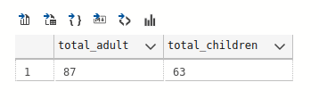
ANALYSIS RESULTS
10. WHAT IS THE TOTAL NUMBER OF ADULTS AND CHILDREN ACROSS ALL RESERVATIONS?
SELECT SUM(NO_OF_ADULTS) AS TOTAL_ADULT,
SUM(no_of_children) AS total_children
FROM hotels
WHERE no_of_adults > 0 AND no_of_children > 0
5

Slide 18
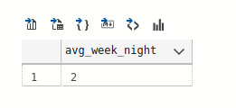
ANALYSIS RESULTS
11. WHAT IS THE AVERAGE NUMBER OF WEEKEND NIGHTS FOR RESERVATIONS INVOLVING CHILDREN?
SELECT AVG(NO_OF_WEEK_NIGHTS) AS AVG_WEEK_NIGHT
FROM hotels
WHERE no_of_children > 0
5

Slide 19
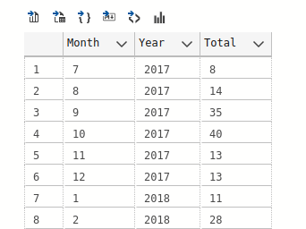
ANALYSIS RESULTS
12. HOW MANY RESERVATIONS WERE MADE IN EACH MONTH OF THE YEAR?
SELECT MONTH(ARRIVAL_DATE) AS MONTH,
YEAR(arrival_date) AS Year,
COUNT(*) AS Total
FROM hotels
GROUP BY YEAR(arrival_date),
MONTH(arrival_date)
ORDER BY [Year], [Month]
5

Slide 20
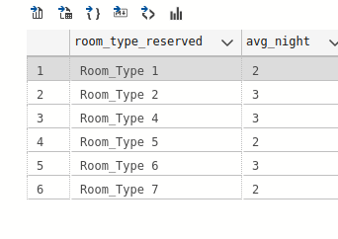
ANALYSIS RESULTS
13. WHAT IS THE AVERAGE NUMBER OF NIGHTS (BOTH WEEKEND AND WEEKDAY) SPENT BY GUESTS FOR EACH ROOM
TYPE?
SELECT ROOM_TYPE_RESERVED, AVG(NO_OF_WEEK_NIGHTS + NO_OF_WEEKEND_NIGHTS) AS AVG_NIGHT
FROM hotels
GROUP BY room_type_reserved
5

Slide 21
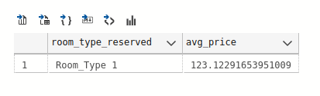
ANALYSIS RESULTS
14. FOR RESERVATIONS INVOLVING CHILDREN, WHAT IS THE MOST COMMON ROOM TYPE, AND WHAT IS THE AVERAGE
PRICE FOR THAT ROOM TYPE?
SELECT TOP 1 ROOM_TYPE_RESERVED, AVG(AVG_PRICE_PER_ROOM) AS AVG_PRICE
FROM hotels
WHERE no_of_children > 0
GROUP BY room_type_reserved
ORDER BY COUNT(*) DESC
5

Slide 22
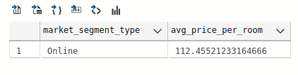
ANALYSIS RESULTS
15. FIND THE MARKET SEGMENT TYPE THAT GENERATES THE HIGHEST AVERAGE PRICE PER ROOM.
SELECT TOP 1 MARKET_SEGMENT_TYPE, AVG(AVG_PRICE_PER_ROOM) AS AVG_PRICE_PER_ROOM
FROM hotels
GROUP BY market_segment_type
ORDER BY avg_price_per_room DESC
5

Slide 23
THANK YOU
PRESENTED BY
BONI ACOBE ANGE ULRICH -- MIP-DA-10
Notes:
we leverage hotel dataset with SQL to improve decision-making and customer experience
this image shoz=ws the differents columns that characterize our dataset
this image shows the import of our dataset in csv format into our database mentorness

